Slide 1
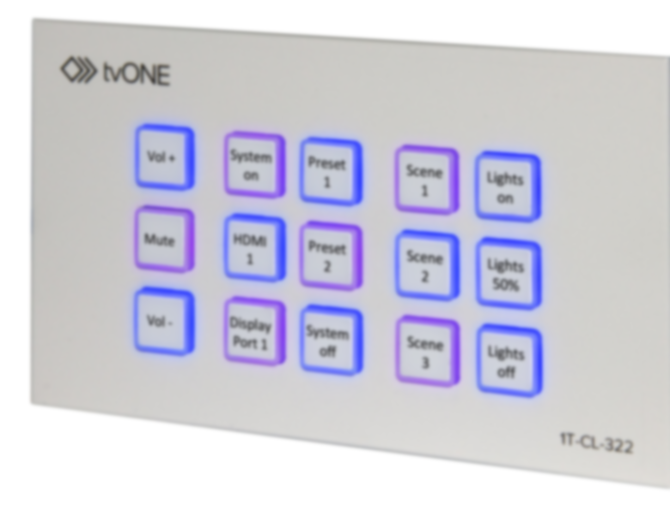
Control Panel
1T-MV-8474
Name
Role

Slide 2
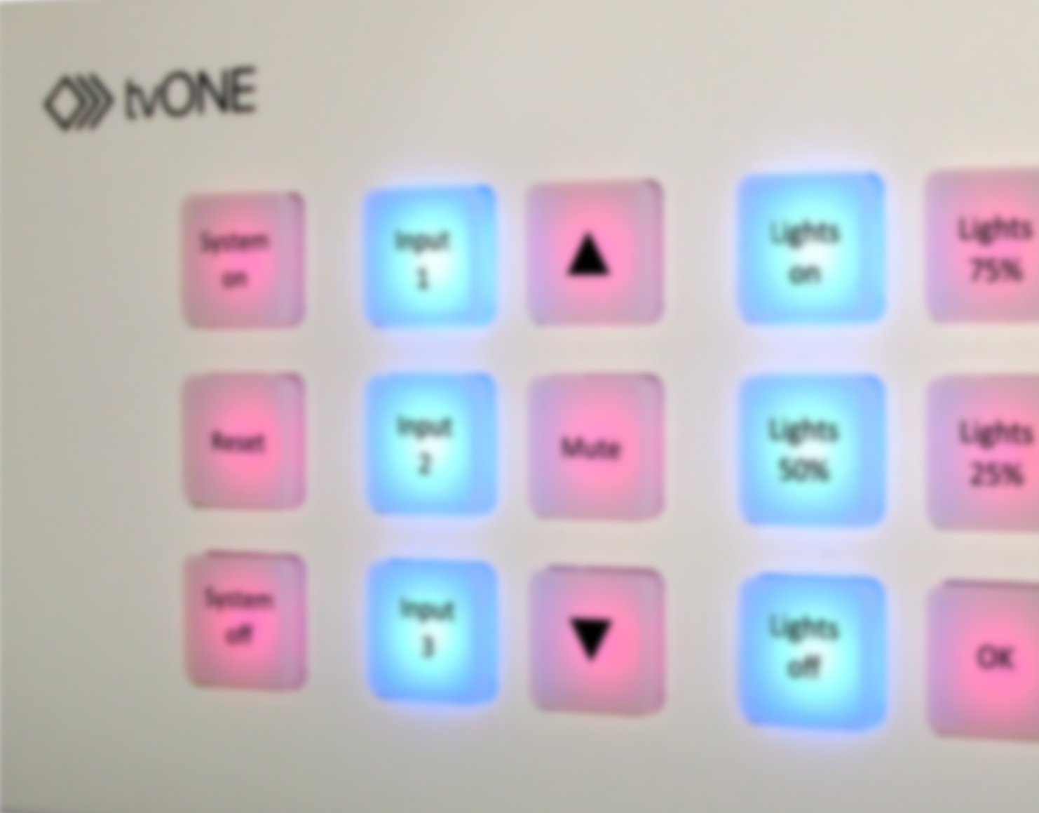
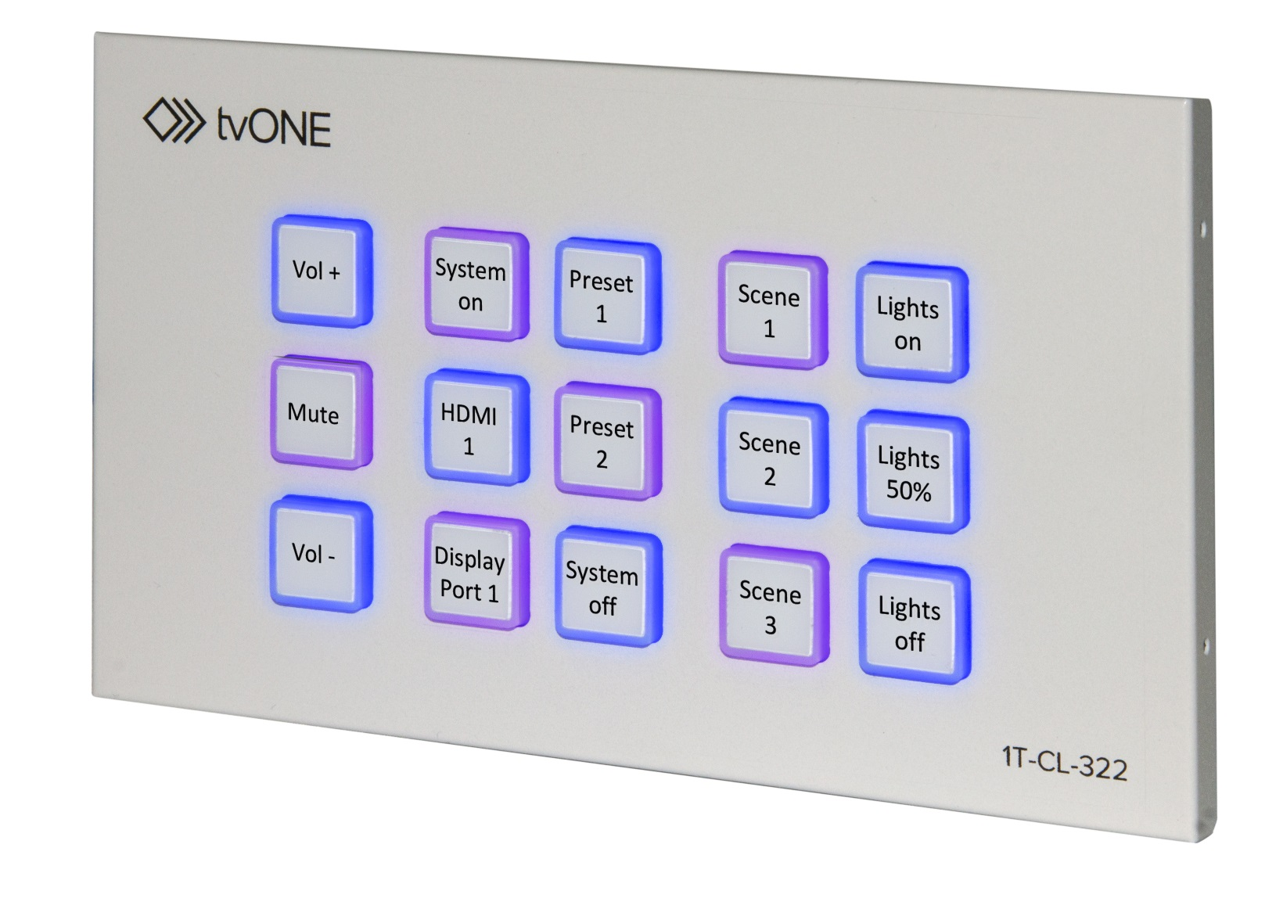
1T-CL-322-EU Control Panel
1T-CL-322-EU Control Panel
Easy to use
Highly Flexible
Cost Effective

Slide 3
1T-CL-322-EU Overview
1T-CL-322-EU Control Panel
Panel
  15 Programmable Buttons
  Control devices by Ethernet or relays for contact closure
  Recall 16 commands from single button push
Other Features
  Seven day scheduling
  Static or DHCP Ethernet
  PoE support
Web Interface
  Set up, control & manage multiple 1T-322-EU panels
  Panel Emulation mode
  Discovery application
15 Button Universal Control Panel:
  Buttons
    15 programmable, backlit buttons for single function or macro
    Allows complex Presets by utilising 16 from 128 stored commands in a single button push
  Connections
    Ethernet port with Static or DHCP options & POE support
    2 Relay Outputs to trigger mechanical devices
  Scheduling
    Seven day scheduling including Power On/Off or scene changing
    LED Button Logic can be configured for user feedback

Slide 4
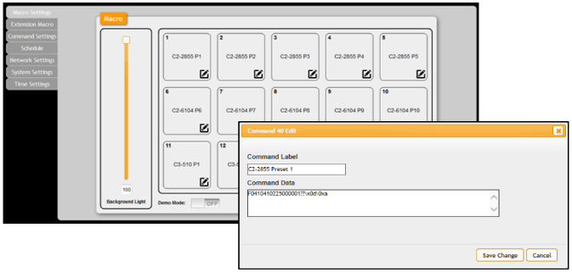
1T-CL-322-EU Programming
1T-CL-322-EU Control Panel
Panel
  15 Programmable Buttons
  Control devices by Ethernet or relays for contact closure
  Recall 16 commands from single button push
Other Features
  Seven day scheduling
  Static or DHCP Ethernet
  PoE support
Web Interface
  Set up, control & manage multiple 1T-322-EU panels
  Panel Emulation mode
  Discovery application
Programming
  Simple, flexible Web GUI to manage multiple panels across a network
  Web GUI includes Panel Emulator
  Includes Discovery application for PC search for panels

Slide 5
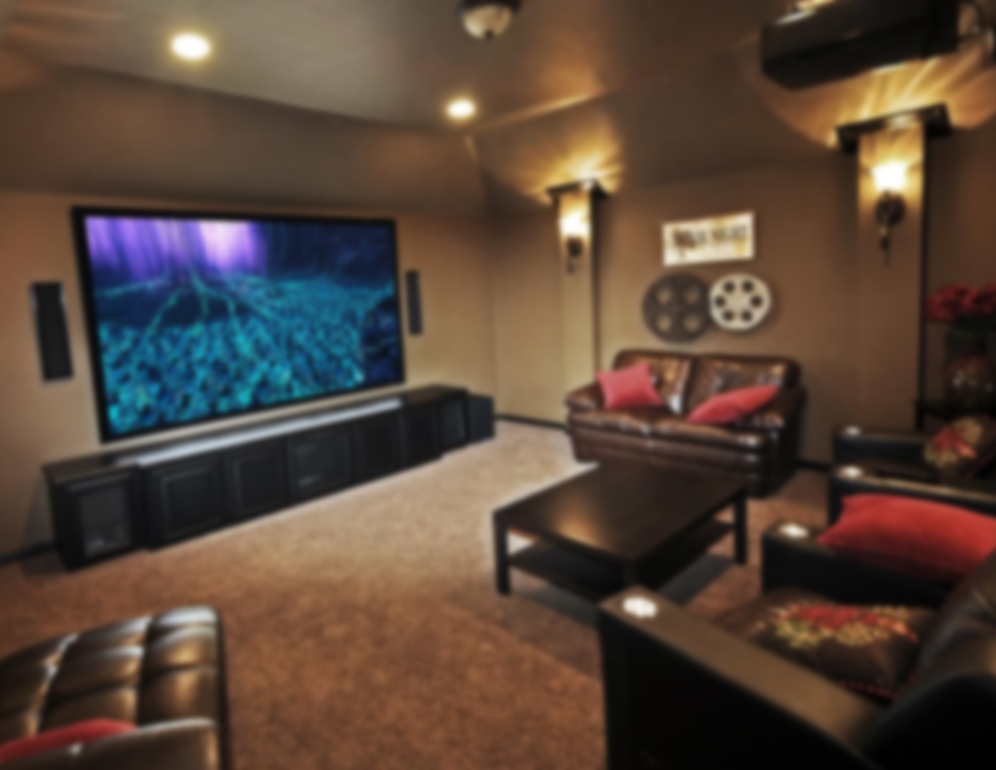
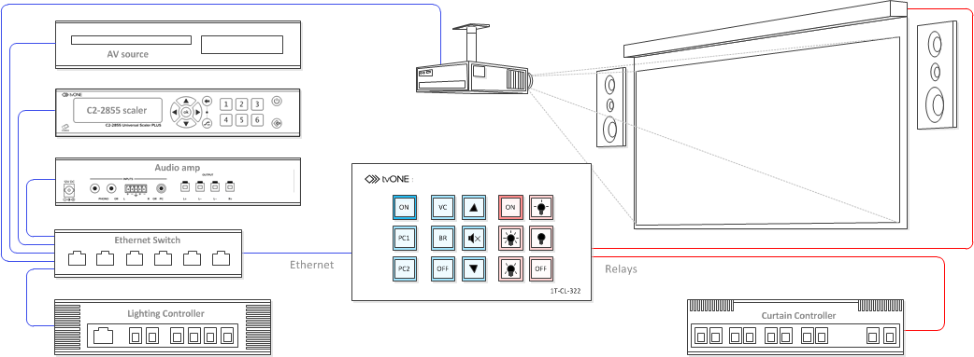
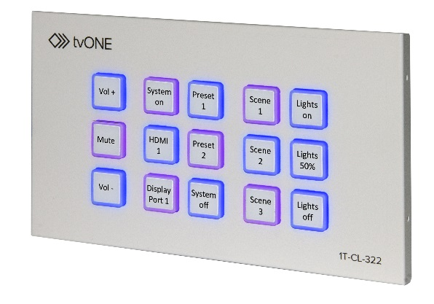

1T-CL-322-EU Application
1T-CL-322-EU Control Panel
Panel
  15 Programmable Buttons
  Control devices by Ethernet or relays for contact closure
  Recall 16 commands from single button push
Other Features
  Seven day scheduling
  Static or DHCP Ethernet
  PoE support
Web Interface
  Set up, control & manage multiple 1T-322-EU panels
  Panel Emulation mode
  Discovery application

Slide 6
1T-CL-322-EU
1T-CL-322-EU Control Panel
Panel
  15 Programmable Buttons
  Control devices by Ethernet or relays for contact closure
  Recall 16 commands from single button push
Other Features
  Seven day scheduling
  Static or DHCP Ethernet
  PoE support
Web Interface
  Set up, control & manage multiple 1T-322-EU panels
  Panel Emulation mode
  Discovery application
Easy to Use
  Simple to programme & highly flexible in use
Highly Flexible
  Control multiple devices over Ethernet and with contact closure relays
Cost Effective
    No need to pay for expensive control system programmers or dedicated control PC’s

Slide 7
Any Questions?
1T-CL-322-EU Control Panel
Easy to use
Highly Flexible
Cost Effective

